Slide 1
The Hero’s Quest
• Heroes are often “more than human.”
o Offspring of a god and a human
o Superhuman strength or ability; crafty and intelligent
• Heroes rise from lowly beginnings or unhappy circumstances.
o Foster parents or single mother/Abandoned by father
o Poverty
• Heroes complete seemingly impossible tasks.
o Kill monsters
o Outsmart enemies
o Overcome “impossible obstacles” against all odds
• Heroes reclaim their rightful place in life.
o Find/Overthrow father or evil ruler
o Take back rightful throne o Defeat enemies who sought to destroy them
• Heroes get help from gods/goddesses
Notes:
http://wolfmanenglishteacher.com/CommonThemesinMythology.pdf

Slide 2
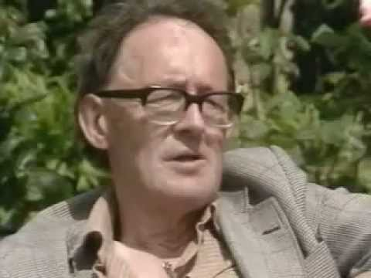
Sir Edmund Leach (1910-1989)
https://www.youtube.com/watch?v=3hnj0wiFPqk
(From 39:00 to 43:00)

Slide 3
Man & God

Slide 4
http://www.pbs.org/wgbh/pages/frontline/shows/religion/story/mmmark.html

